Slide 1


ELEL 5882M
19th Weekly Report
06/03/2024
Junnan Liu
201715540
el23jl2@leeds.ac.uk

Slide 2

What is Op amp ?
Suppose we want to multiply an input by a number to produce another voltage that we will refer to as the output.
Or we have several input and we with to add them together as the output voltage.

Slide 3
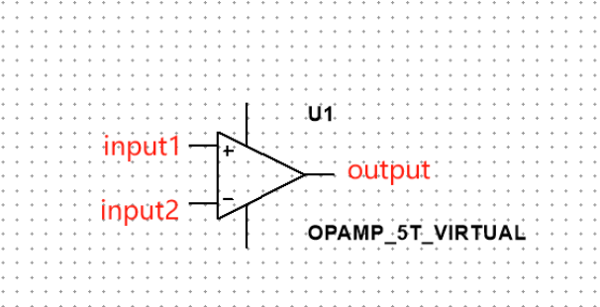
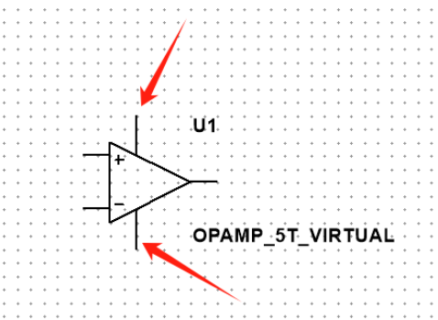
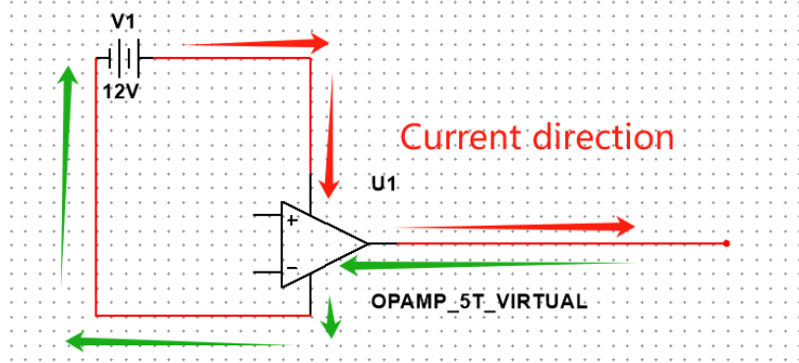
The Feature of Op amp
Notes:
In our project this amplifier has five channels and has two input terminals and one output terminals.
It also has two terminals for providing power to the device.
Current can never flow into or out of the input terminals. But the Current can flow into or out of the output terminals.

Slide 4
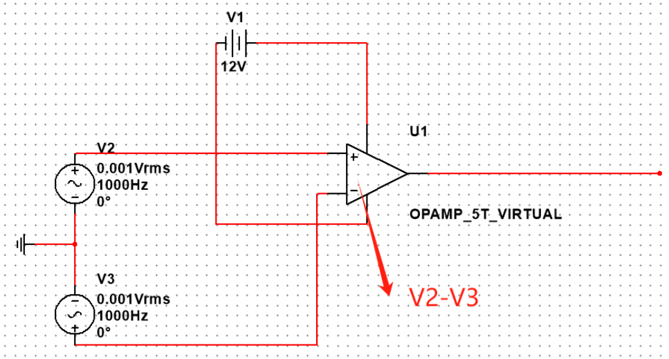
The Role of the Differentiator
Notes:
The output voltages only are in between the voltages of the two power terminals. As the figure show above, the range of output voltages are from -12V to 12V.
The op amp takes the voltage value of the "+" input and subtracts from it the voltage value of the "-" input.

Slide 5
Question & Answer
Why count the difference instead of just taking a value and amplifying it directly?
1. Reject interference or noise
2. Many scenarios require differential amplification
3. Precise signal amplification
Notes:
Why count the difference instead of just taking a value and amplifying it directly?
First, By comparing the differences between two input signals, an op amp is able to reject interference or noise (called a common-mode signal) experienced by both inputs. thus improving signal accuracy and stability.
Second, Many scenarios require differential amplification, such as reading sensor signals, what needs to be amplified is the difference between two voltage points, rather than the absolute value of a single voltage relative to ground.
Third, Precise signal amplification: Calculating the difference between two inputs allows amplification of very small signal changes

Slide 6
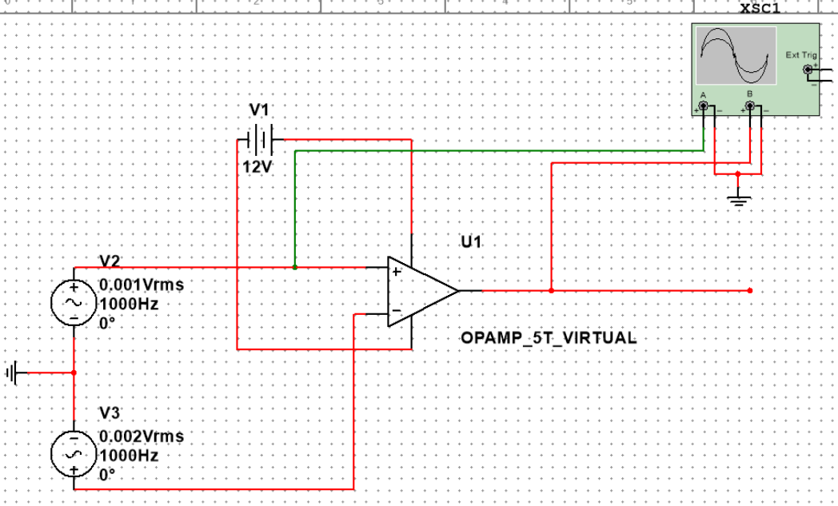
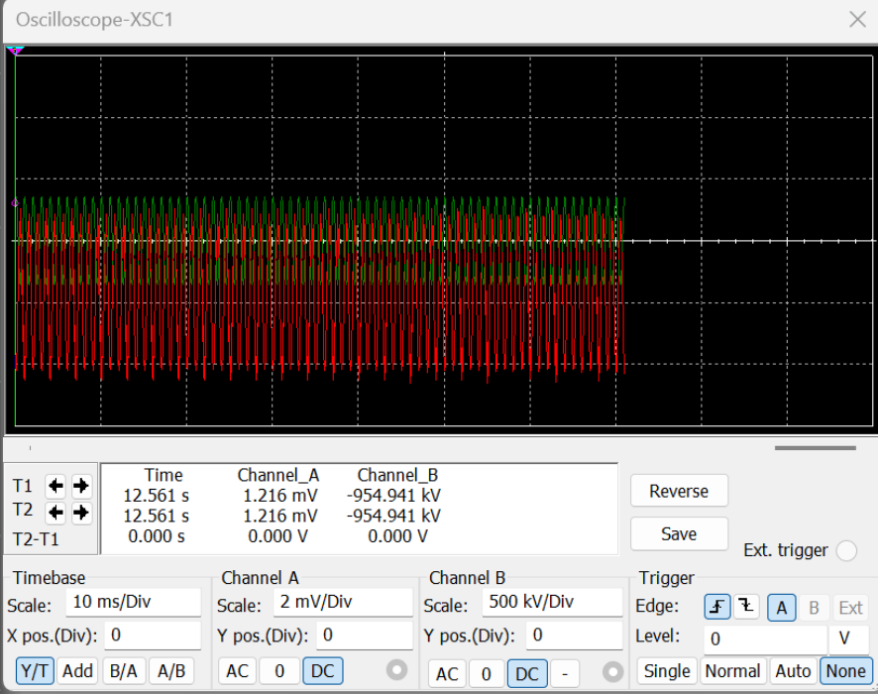
Analysis
When the "+" input is slightly lower than the "+" input, the op amp will try to make the output voltage equal to the largest negative number it is capable of producing.
Notes:
When the "+" input is slightly lower than the "+" input, the op amp will try to make the output voltage equal to the largest negative number it is capable of producing.
In this picture, the Channel_B is connect with the output, and the Channel_A is connect with the "+" input, we can see the output voltage is a very large negative voltage around -954kV while the channel_A is just 1.216 mV, which is just since the V2 is 0.001Vms and V3 is 0.002Vms.

Slide 7
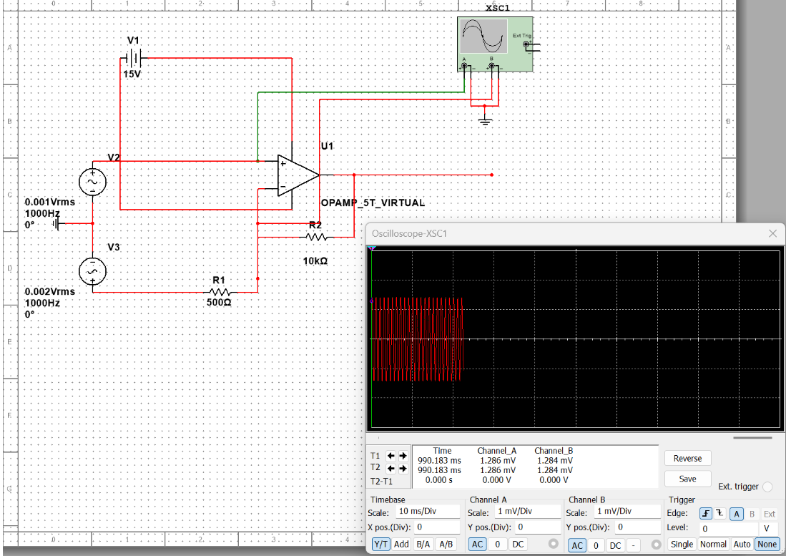
Analysis
When the "+" side of the input add the resistance R1 and the R2 with negative feedback circuit, if the voltage of V2 is less than V3
Notes:
when the "+" side of the input add the resistance R1 and the R2 with negative feedback circuit, if the voltage of V2 is less than V3, then part of the voltage amplified from output will come back to the "+" side input. In conclusion, both "+" and "-" side voltage will become the same level finally since the negative feedback circuit.

Slide 8
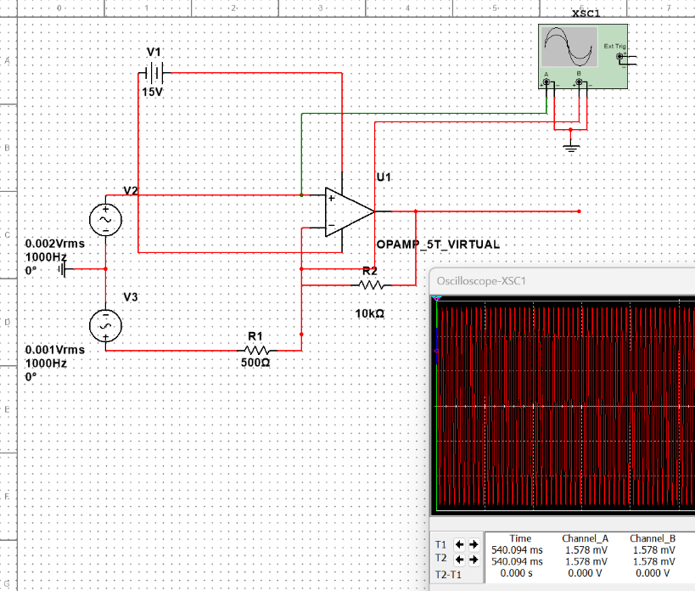
Analysis
When the voltage of the V2 is larger than the V3, the voltage of the A and B still the same finally
Notes:
when the voltage of the V2 is larger than the V3, the voltage of the A and B still the same finally .Because the negative feedback always forces the op amp's two terminals to always be at almost the same voltage value.

Slide 9
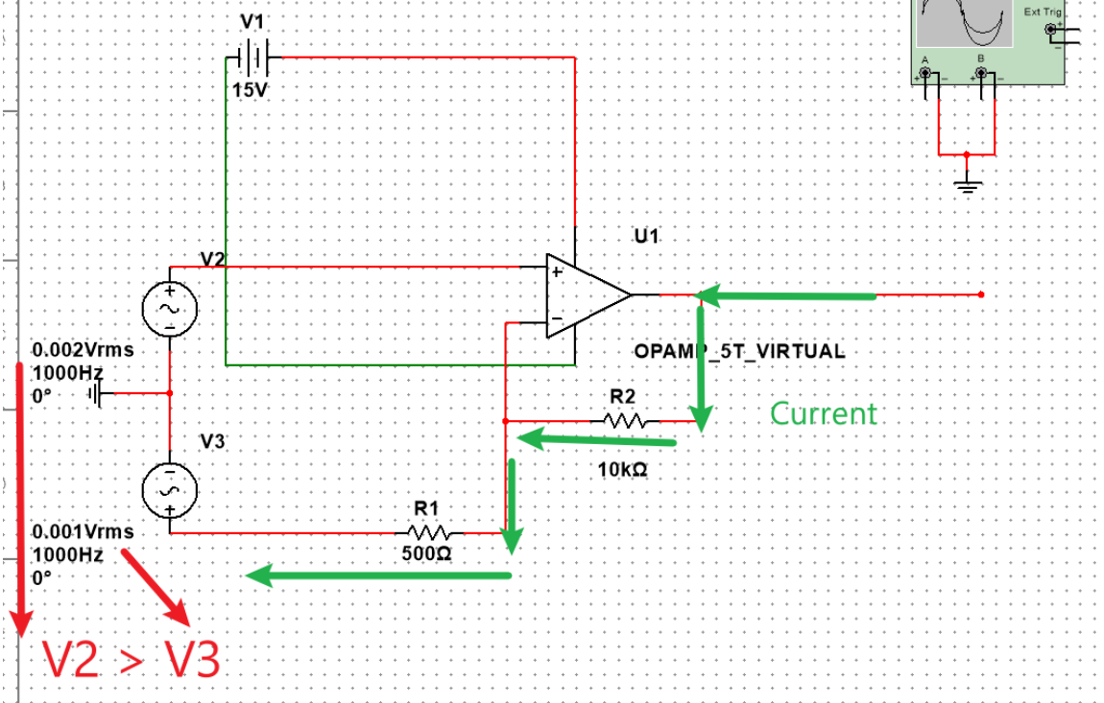
Analysis
Notes:
when the voltage of non-inverting input larger than the inverting input, the output voltage will increase .The Current will flow from output to inverting input while it cannot flow into the op amp.

Slide 10
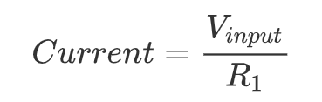
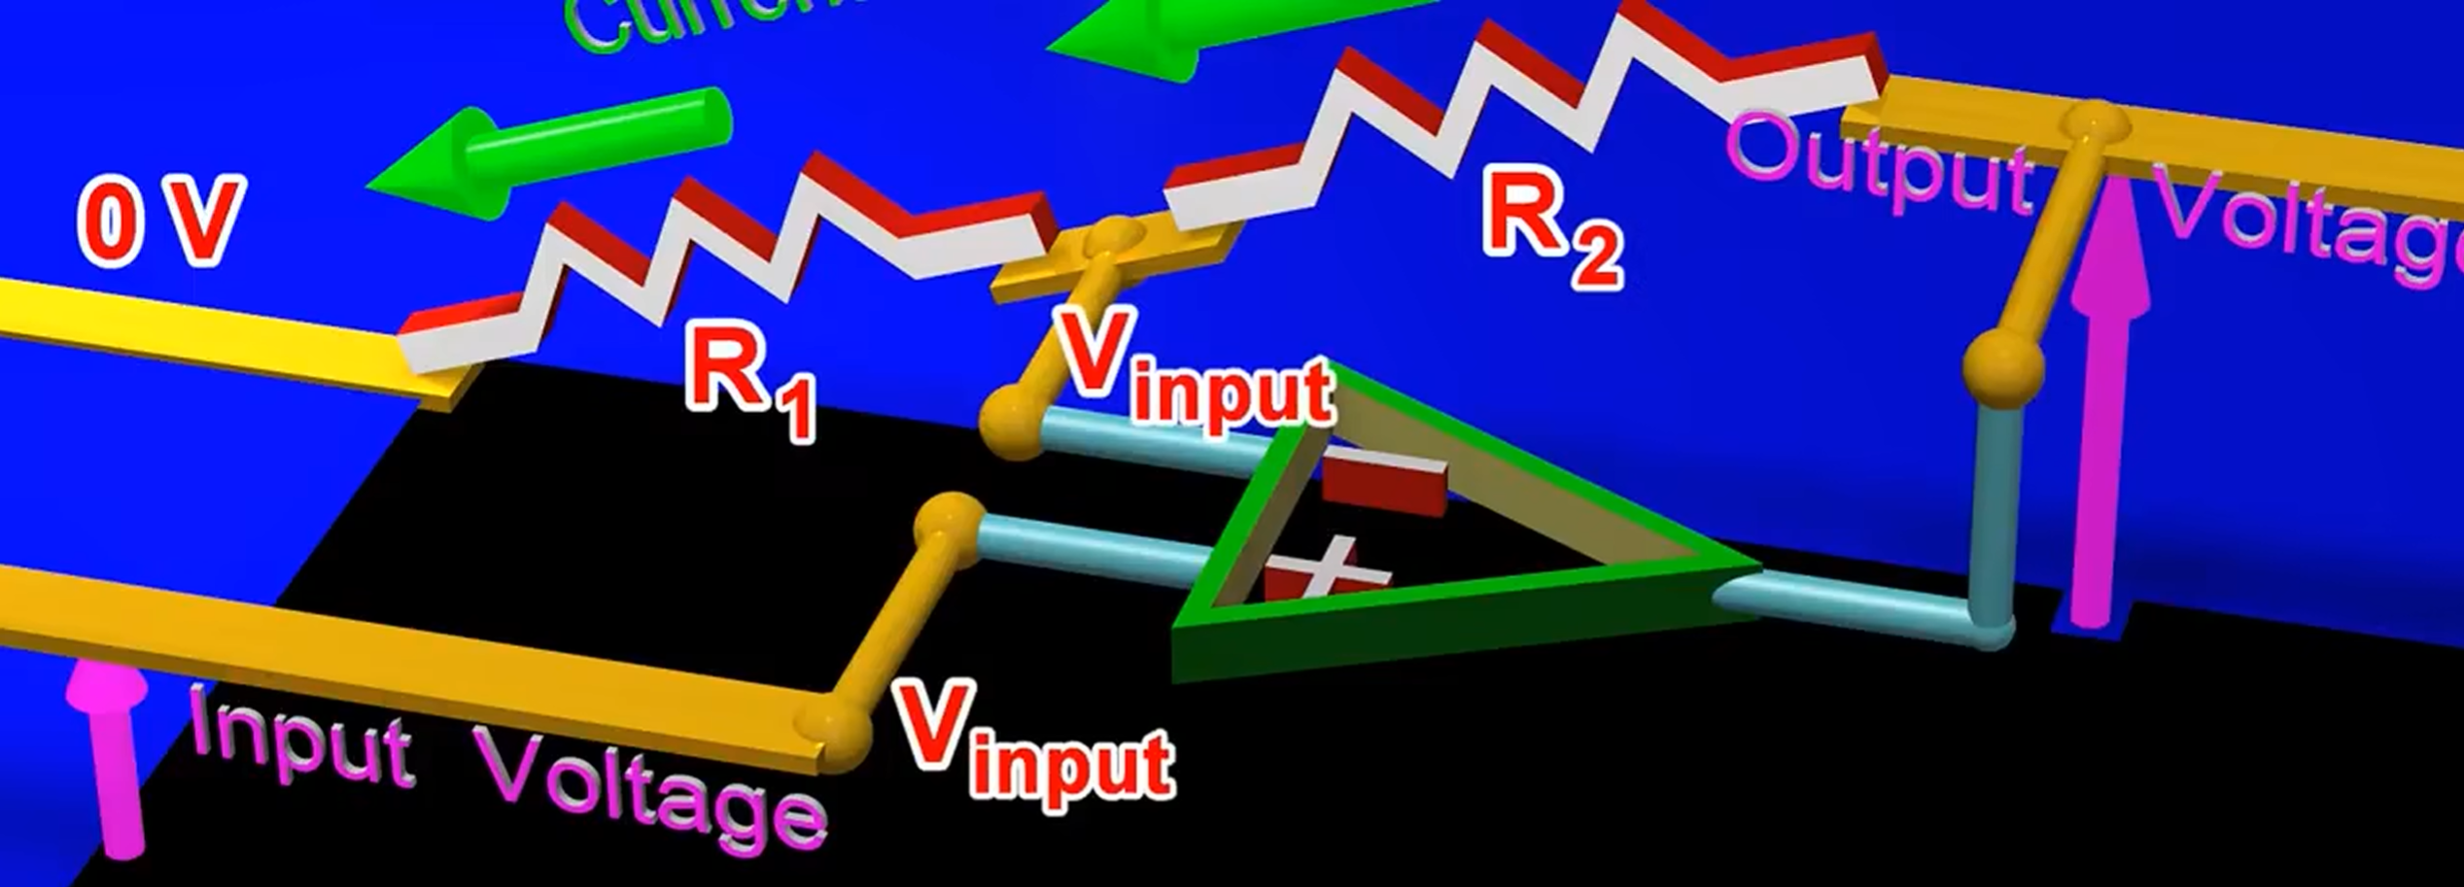
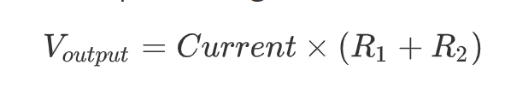
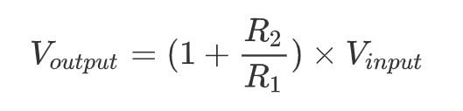
Analysis
Notes:
Since the current of inverting input is the same as the current of output. Thus we can get the current through:
Consequently, we can calculate the V_output through below formula:
Finally we get the formula related to V_output and R1,R2 and V_input:

Slide 11
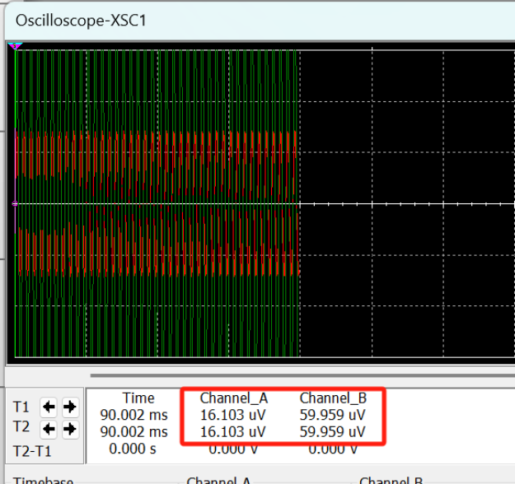
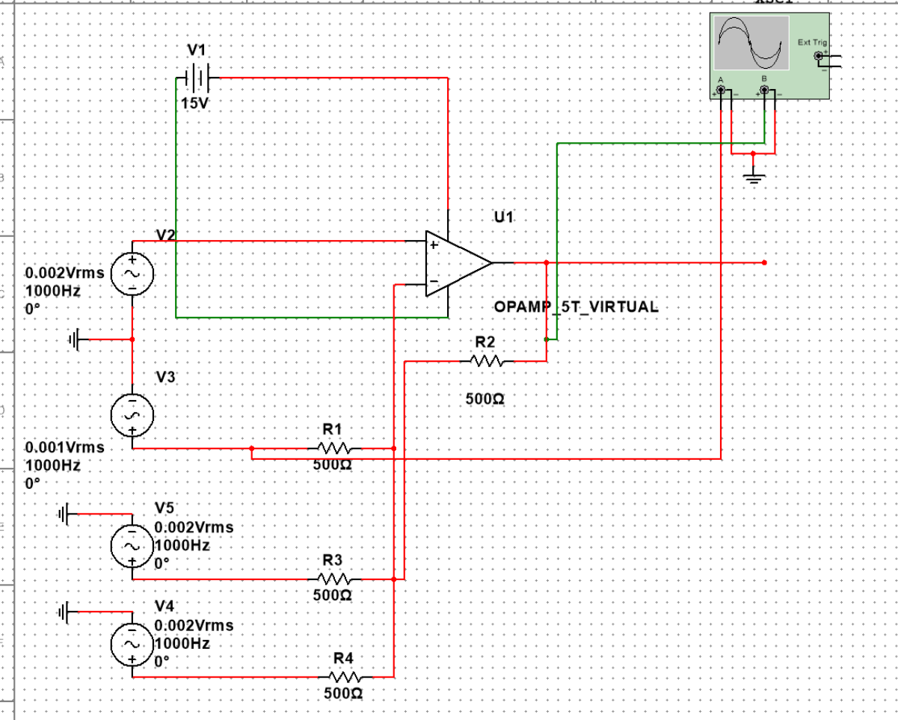
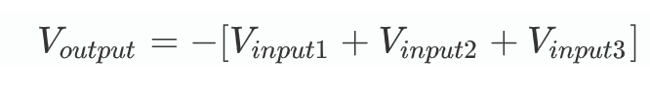
Op amp as adder
Notes:
We use V3, V4 and V5 to simulate the the circuit in parallel connects to inverting input, and the resistance of R1,R2,R3 and R4 are the same.
Using the Oscilloscope to check the current of R1 and R2. We can observe that the value of A and B are around 3 times related. Thus we can infer the relation as follows:

Slide 12
PLAN NEXT WEEK
Understand the principles
of full-wave rectifiers
Numerical insights into EMG’s
Instrumentation Amplifier.
01
03
02
04
Numerical insights into
EMG’s High Pass Filter
Numerical insights into
EMG’s full-wave rectifiers
Notes:
Numerical insights into EMG’s Instrumentation Amplifier
Understand the principles of high-pass filters
Numerical insights into EMG’s High Pass Filter
Understand the principles of full-wave rectifiers
Numerical insights into EMG’s full-wave rectifiers

